Slide 1
Schlumberger – OFS1 / New to Canada Payroll Employee Benefit Presentation 2020

Slide 2
Agenda
Schlumberger’s Flexible Health Benefits
Flex Benefit Options – Health, Dental, Insurance & Disability
How to select the right benefits for you
How to Enroll online
Managing your claims throughout the year
Employee and Family Assistance Program
Schlumberger’s Financial Benefits
Retirement Savings Plan
Defined Contribution Pension Plan (DCPP), Deferred Profit Sharing Plan (DPSP)
Group Registered Retirement Saving Plans (RRSPs), Tax Free Savings Accounts (TFSA)
Discounted Stock Purchase Plan (DSPP)
Resources & Questions

Slide 3
New to Canada?

Slide 4
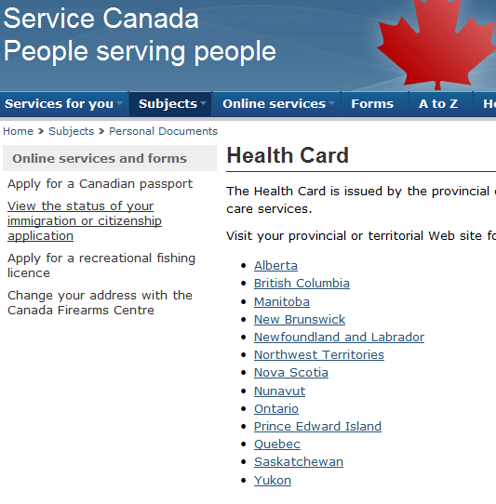
Provincial Health Care Plans
The Schlumberger group health plan works in conjunction with the government sponsored health plan
You must be a member of the provincial healthcare plan to participate in the Schlumberger group plan
To apply and obtain a provincial health care card visit Service Canada:
https://www.canada.ca/en/health-canada/services/health-cards.html

Slide 5
Flex Benefit Options Health, Dental, Insurance & Disability

Slide 6
Introduction to Flex Benefits
Employees have a variety of benefits to choose from
Each benefit has different options with different price tags
Schlumberger provides enough flex dollars to pay the full cost of option 2 for both extended health and dental coverage
What they don’t pay for with flex dollars, they cover with payroll deductions
Employees receive additional flex dollars to use where they choose ($300)
If there are leftover flex dollars, the employee can deposit them into their Health Care Spending Account (HCSA) or Personal Spending Account (PSA)
Employees enroll in their benefits every fall during the 3 week Annual Enrollment (AE) period
Choices made during Annual Enrollment take effect January 1 of the following year

Slide 7
Schlumberger Flex
Core Flex | Extended Health Care (3 Options) | Dental Plan (4 Options) | Long-Term Disability (4 Options)
 | Basic Life Insurance (Employee, Spouse and Child) | Basic AD&D (Employee) | Business Travel Accident (Employee + Spouse)
Optional Flex | Optional Life Insurance (Employee, Spouse and Child) | Optional AD&D (Employee, Spouse & Child) | Optional Critical Illness (Employee, Spouse & Child)

Slide 8
Covering Your Dependents


You can cover:
Yourself
Yourself + one dependent
Yourself + two or more dependents


Notes:
Full-time students are eligible for coverage up to their 26th birthday
The price tag is the same no matter how many children you cover.
Your selected dependent coverage is the same for both Medical and Dental, but you can choose different options in each

Slide 9
Extended Health
 | Option 1 + Flex $ | Option 2 | Option 3
Paid for by | Schlumberger | Schlumberger | Cost-Share
Reimbursement For all eligible expenses | 60% | 90% | 100%
Prescription drugs deductible | Dispensing fee | Dispensing fee | Dispensing fee
Hospital | Semi-private | Semi-private | Private
Vision care (24 months) | None | $150 | $350
Paramedical services
Maximum per practitioner | $500 | $500 | $1,000
Annual combined max | $1,500 | $1,500 | $1,500
Psychologist services (Annual max) | $500 | $1,000 | $1,500
Orthotics (every 36 months for adults /12 months for children) | $400 | $400 | $400
Out of country Medical 90 days | 100% | 100% | 100%

Slide 10
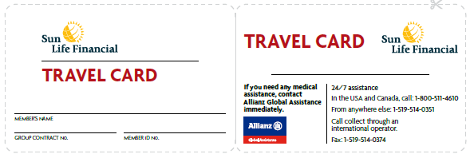
Emergency Medical Travel Assistance
For use with business or personal travel (can be used in Canada outside of your province, or anywhere outside of Canada)
Covers a variety of costs resulting from a medical emergency while traveling (read Emergency Travel Assistance section of Your Group Benefits booklet for full services offered)
Treatment charges are paid by the employee and then reimbursed through the Sun Life
Service provider is Allianz Global Assistance

Slide 11
Dental
 | Option 1 + Flex $ | Option 2 | *Option 3 | Option 4 + Flex $
Paid for by | Schlumberger | Schlumberger | Cost-Share | Schlumberger
Deductible | None | None | None | No coverage
Basic dental Recall exams Periodontics | 60% 6 months 16 units | 90% 6 months 16 units | 100% 6 months 16 units
Major dental Crowns | 50% Included | 70% Included | 80% Included
Combined maximum | $1,500 | $2,000 | $3,000
Orthodontia Under age 18 Lifetime max | No coverage | 50% $2,000 | 50% $3,000
*Option 3 for Dental is locked in for two plan years

Slide 12
Business Travel Accident Insurance
 | You | *Spouse
Paid for by | Schlumberger | Schlumberger
Mandatory | Yes | Yes
Coverage | 4.5 x eligible compensation | $50,000
Maximum | $1,000,000 | $50,000
*Spouse is covered only if Schlumberger requested that they travel with you.
Eligible Compensation is the higher of your base salary or admissible compensation.
Admissible compensation includes base pay, overtime bonuses, commissions, and geographical coefficients.

Slide 13
Basic Life Insurance & AD&D
Basic Life Insurance
Paid for by | Schlumberger
Automatic | Yes
Employee | 2 x your eligible compensation
For your spouse | $10,000
For your child(ren) | $5,000
Basic Accidental Death and Dismemberment
Paid for by | Schlumberger
Automatic | Yes
Employee | 2 x your eligible compensation
For your spouse | N/A
For your child(ren) | N/A

Slide 14
Optional Life and AD&D
Optional Life and Accidental Death and Dismemberment Insurance
Paid for by | Employee
Automatic | No
Coverage Options
Employee | Up to $500,000 in coverage in multiples of $25,000
For your spouse | Up to $500,000 in coverage in multiples of $25,000
For your child(ren) | Up to $25,000 in coverage in multiples of $5,000
Optional life coverage requires evidence of insurability (EOI)

Slide 15
Optional Critical Illness
Optional Critical Illness
Paid for by | Employee
Automatic | No
Coverage Options
Employee | Up to $250,000 in coverage in multiples of $10,000 (starts at $20,000)
For your spouse | Up to $250,000 in coverage in multiples of $10,000 (starts at $20,000)
For your child(ren) | Up to $5,000 in coverage
You can select up to $50,000 in coverage without providing EOI ← for new hires only!
Provides a tax-free lump sum that you can spend how you choose
Check out Enrollment Central slb-benefits.ca for more details

Slide 16
Critical Illness (continued)
Covered illnesses include:
Aortic surgery Aplastic anemia Bacterial meningitis Benign brain tumour Blindness Cancer (life-threatening) Coma Coronary artery bypass surgery Deafness Dementia, including Alzheimer’s disease Heart attack Heart valve replacement or repair Kidney failure | Loss of independent existence Loss of limbs Loss of speech Major organ failure on waiting list Major organ transplant Motor neuron disease Multiple sclerosis Occupational HIV infection Paralysis Parkinson’s disease and specified atypical parkinsonian disorders Severe burns Stroke | For children: Cerebral palsy Congenital heart disease Cystic fibrosis Down’s syndrome Muscular dystrophy Type 1 diabetes mellitus *
*
Note:
Check out Enrollment Central slb-benefits.ca for more details

Slide 17
Short-term Disability Coverage
Employee Status | Onset of STD to 26 weeks (max. 6 months) | 27 weeks to 52 weeks (max. 12 months)
Non-Field Direct Employees | 100% of Base Salary | 80% of Base Salary
Schlumberger Field Direct Employees (Operators, field specialists, etc.) | 130% of Base Salary | 110% of Base Salary
STD is a continuation of compensation and employer paid
STD intake through HumanaCare
Employees are provided a disability advocate to provide guidance throughout the duration of their claim, provided through HumanaCare
Sun Life adjudicates claims

Slide 18
Long-Term Disability
 | LTD Option 1 | LTD Option 2 | LTD Option 3 | LTD Option 4
Formula for monthly disability Benefit | 55% of first $3000 of eligible comp + 40% of remainder | 60% of first $3000 of eligible comp+ 50% of next $4000 + 45% of remainder | 65% of first $7500 of eligible comp + 50% of remainder | 65% of first $7500 of eligible comp + 50% of remainder
Indexing (COLA) | None | None | None | Yes, based CPI, to a max of 3% per year
Monthly Benefit Max | $15,000 | $15,000 | $15,000 | $15,000
Definition of disability | First 24 months: your own occupation; Thereafter unable to do any occupation
Benefits payable to | Age 65, retirement, recovery, or death (earliest of)
LTD premiums are paid with after-tax employee dollars, ensuring the benefit received is non-taxable
Premiums are based on admissible compensation
Your LTD is locked in and EOI is required for LTD increases during Annual Enrollment

Slide 19
Leftover Flex Dollars
Health Care Spending Account (HCSA) | Personal Spending Account (PSA) | *Registered Retirement Savings Plan (RRSP)
Cover medical costs not covered by our plan Claim anything claimable as a medical tax credit | Cover health, wellness and personal development | Save for Retirement Reduce taxable income
Expenses claimed are non-taxable | Expenses claimed are taxable | Contribution is taxable
Expires after 2 years Use it or lose it |  | Min $25 contribution Requires RRSP sign up
*Available only during fall Annual Enrollment

Slide 20
Your Health Care Spending Account (HCSA)
Examples of eligible expenses:
The percentage of dental or health care related expenses that you pay
Prescription drug dispensing fees
Eyeglasses, contact lenses, or laser surgery
Orthodontia or dental expenses not covered under your dental option
Health care expenses of relatives who are financially dependent on you, but not covered by Schlumberger Flex, like a parent or sibling or adult child

Slide 21
Personal Spending Account (PSA) Claimable Items
Health-related Services
Weight management programs
Smoking cessation programs
Nutrition and counselling
Maternity services (pre-natal classes and mid-wife services)
Alternative health practitioners: reflexologist, iridologist, herbalist, homeopath, athletic therapist, osteopathic, occupational therapist and acupressurist
Stress management
Cholesterol and hypertension screening
First aid and CPR training
Health assessments
Allergy tests
Vitamins and supplements
Other alternative wellness: Reiki, Ayurvedic medicine, touch therapy, rolfing and light therapy
Insurance Premiums
Long Term Disability
Life and Critical illness
Fitness Equipment
Durable equipment i.e. treadmills, exercise bikes and a universal gym
skates, roller blades, bicycles, tennis racquets, safety helmets, and specialized sports equipment
golf clubs
Educational and Personal Development
Healthy cooking classes
Tuition fees for university, college or continuing education (includes books)
Language training
Tutoring
Professional membership fees or dues
Hobby and general interest classes
Personal computer and accessories
Professional Services
Services of professionals for estate planning, financial counselling, tax return preparation and will preparation
Miscellaneous
Orthopedic mattress or pillow

Slide 22
Your Health Care and Personal Spending Account
The fine print:
Flex dollars expire two plan years after deposit
You must claim expenses in the year they occur
Flex dollars may only be withdrawn to reimburse eligible expenses
If your employment with Schlumberger ends or you are transferred outside of Canada, any eligible claims incurred before you leave must be received by Sun Life within 90 days of your last day at work; after that, your HCSA & PSA dollars will be forfeited
You have two years!

Slide 23
How to select the right benefits for you

Slide 24
What you need to think about
Health and Dental
Look at this year’s claims
Think about what’s changed
Chronic conditions?
The need for major dental work?
Orthodontia planned?
Talk to your doctor and dentist

Slide 25
What you need to think about (continued)
Life and Accident Coverage
Think about your current financial obligations
Determine what your future income needs will be
What would your family need if you weren’t there?
Consider other insurance coverage you may have

Slide 26
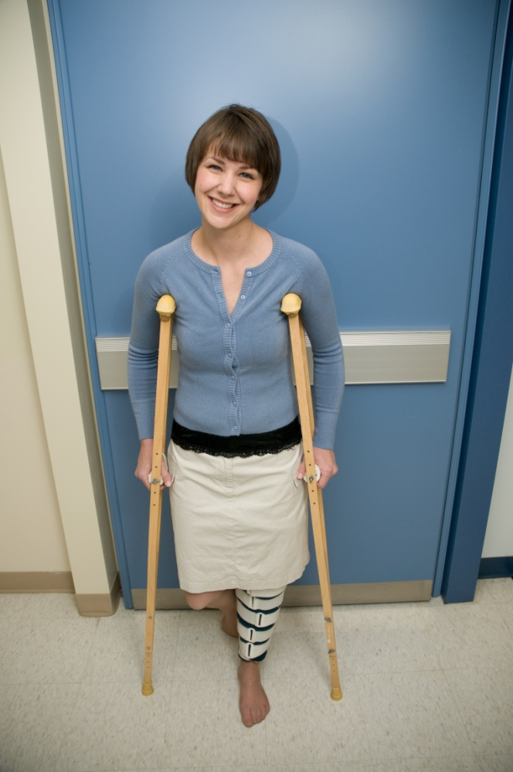
What you need to think about (continued)
Long-Term Disability
Think about your current financial obligations
Consider other family income
Determine what your future income needs will be

Slide 27
Coordinating Your Benefits
Does your spouse have a benefit plan?
Receive up to 100% coverage by coordinating your two plans
By choosing a lower option with a less expensive price tag, you’ll have more flex dollars to direct elsewhere or deposit into your HCSA/PSA.

Slide 28
What you need to think about (continued)
Taxable Benefits
Premiums on a number of benefits are taxable
You’ll see the amount on your pay slip
You pay tax on:
Flex dollars used to pay for life insurance
Flex dollars used to pay for accident insurance
Business travel accident insurance premiums
Personal Spending Account reimbursements

Slide 29
How to Enroll

Slide 30
How to Enroll
Step 1: Go to Enrollment Central https://slb-benefits.ca and click ‘Employee Self Service’

Slide 31
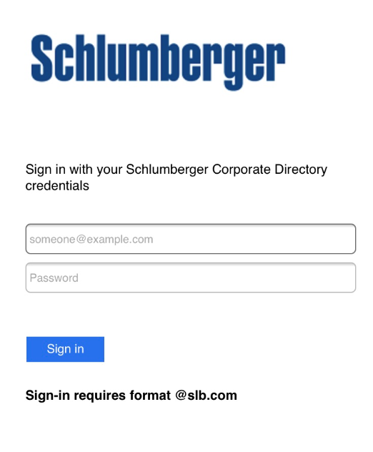
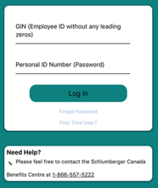
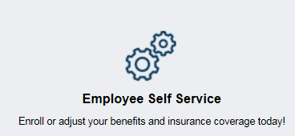
How to Enroll
SLB Computer Home Computer Mobile App
Single Sign On (SSO) Sign in using your LDAP Sign in using your
no log in credentials and password GIN and PIN
(App Name – Flexplus)
Employer name: SLB
Schlumberger Canada Benefits Centre
Toll-free at 1-866-557-5222
Hours:
6:00am to 3:00pm MST

Slide 32
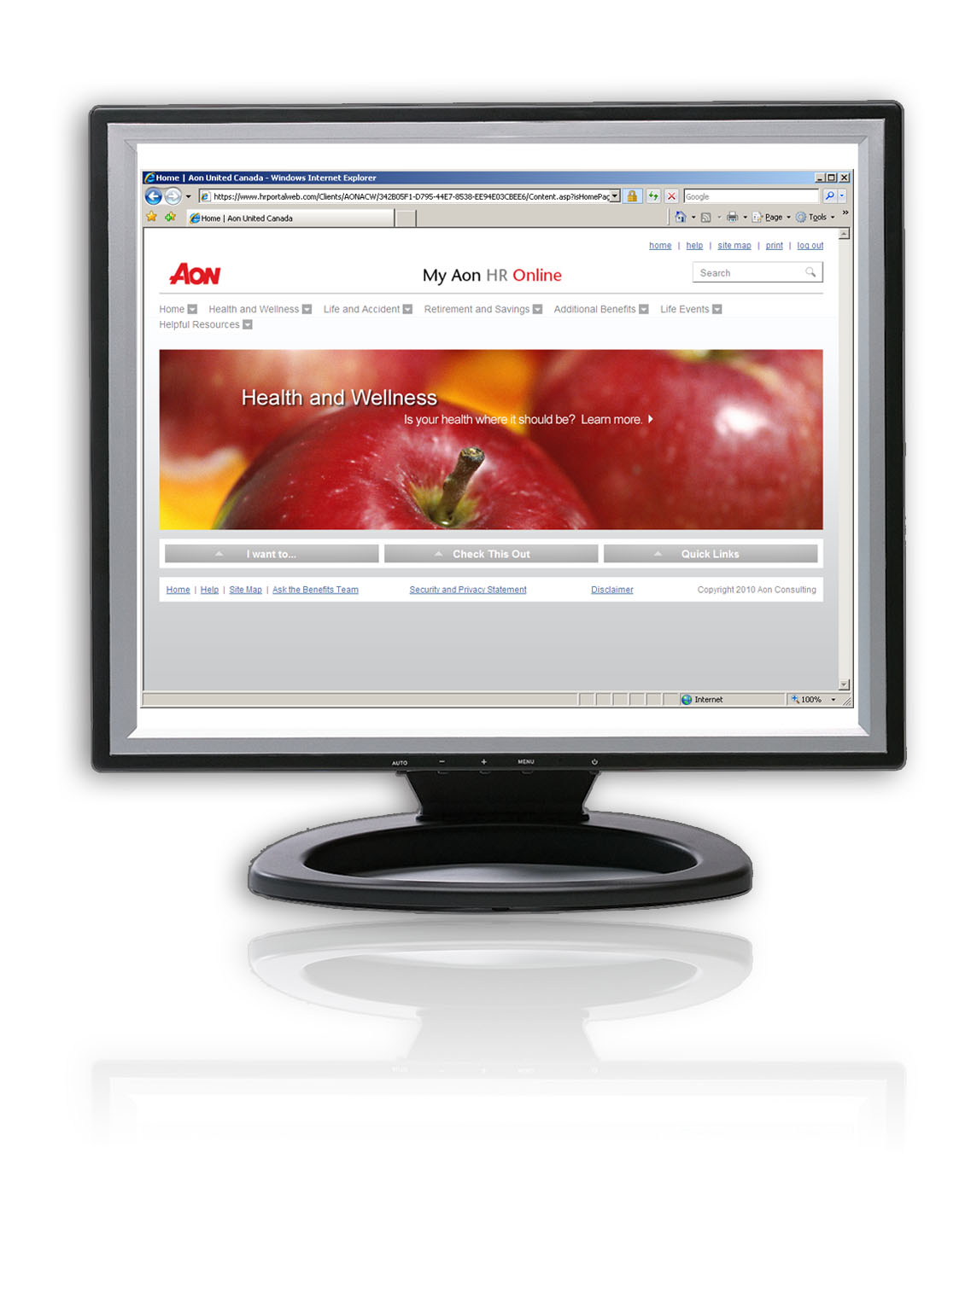
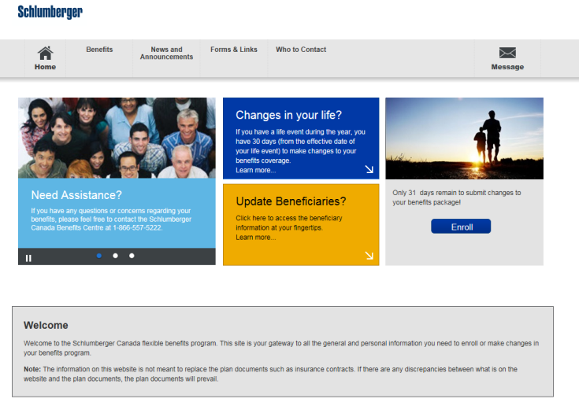
How to Enroll (continued)
Step 2: Select your benefits
The enrollment website will guide you to
Verify your contact information
Verify your dependent information
Choose your benefit options for you and your dependents
Allocate any excess flex dollars to your HCSA or PSA
Create/Review your beneficiary(ies)
https://schlumberger.seb-admin.com

Slide 33
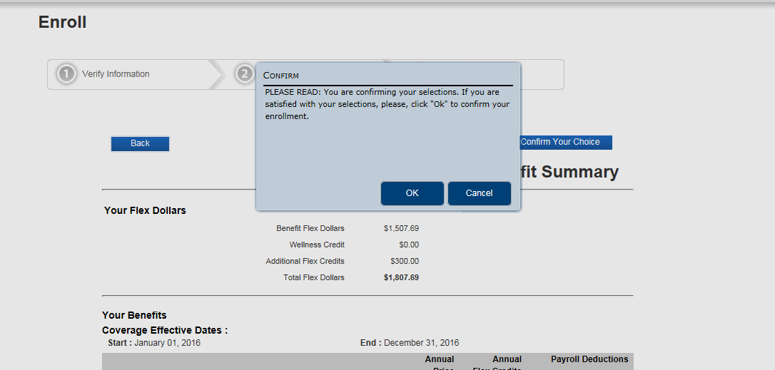
How to Enroll (continued)
Step 2: Select your flex benefits
Confirm and submit your selections
Once you click on “OK” your choices will be saved and will become your coverage for next year
https://schlumberger.seb-admin.com

Slide 34
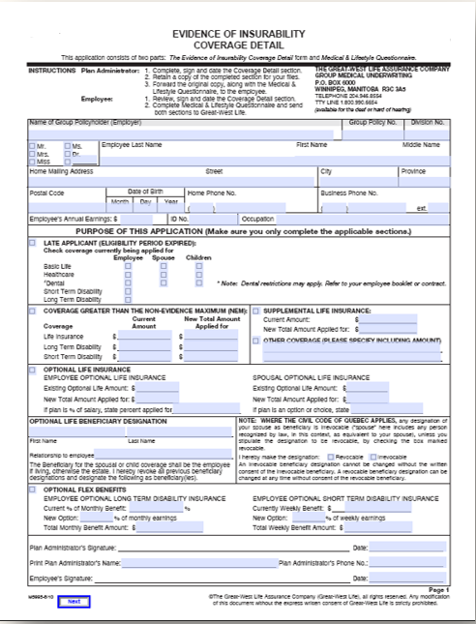
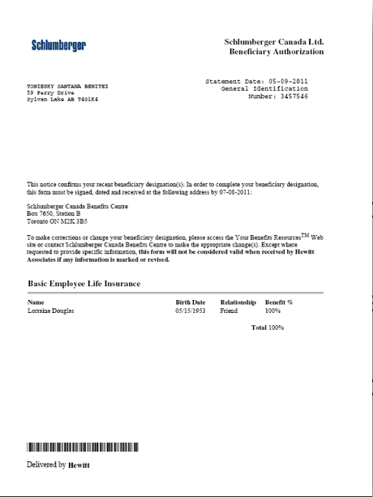
How to Enroll (continued)
Step 3: Complete your forms
You may need to complete beneficiary designation forms for your life and AD&D insurance
If you choose optional life insurance for you or your spouse, you will need to fill out an Evidence of Insurability (EOI) form
If you don’t return your signed forms, your changes, including any new beneficiary designation, will not take effect

Slide 35
How to Enroll (continued)
If you don’t enroll
Benefit | Default Coverage
Extended Health Care | Option1
Provincial Health Care (BC only) | Current coverage
Dental | Option1
Basic Employee Life | 2 x eligible compensation
Basic Spouse Life (if on file) | $10,000
Basic Child Life (if on file) | $5,000
Basic AD&D | 2 x eligible compensation
Long Term Disability (LTD) | Option1
Any excess flex dollars | Deposited to your Personal Spending Account

Slide 36
Changing Your Benefits
Life changes! So can your benefits
There are two types of opportunities to change your coverage:
During the annual enrollment period each year (Fall)
After you have a life event
Be sure to make your benefit changes on the enrollment tool within 30 days of any life event
https://schlumberger.seb-admin.com
Life events include marriage, divorce, the birth or adoption of a child, the death of a dependent, or your spouse losing his or her benefits coverage.

Slide 37
Managing your claims throughout the year

Slide 38
Submitting Your Claims
Sun Life is the benefits provider for Schlumberger Flex
You can submit claims many ways:
Paper forms
Online via Sun Life website
Mobile App (for iPhone, Android)
Automatically with your Assure Card (prescription drugs) at the pharmacy
Personal Spending Account claims may only be submitted via paper claim form

Slide 39
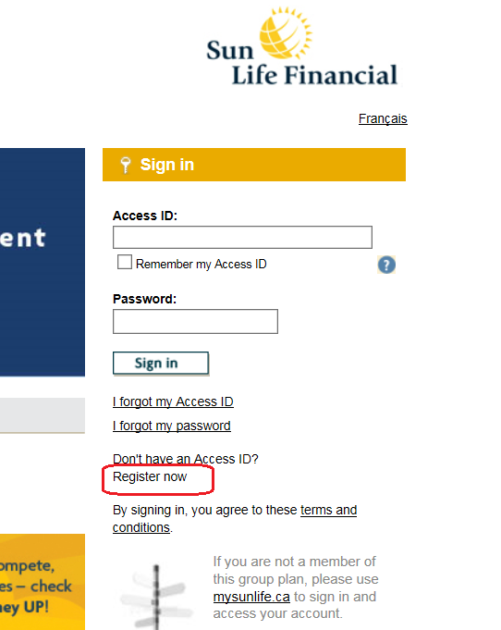
Sign up for Sun Life
Go to www.mysunlife.ca
Click “Register now”

Slide 40
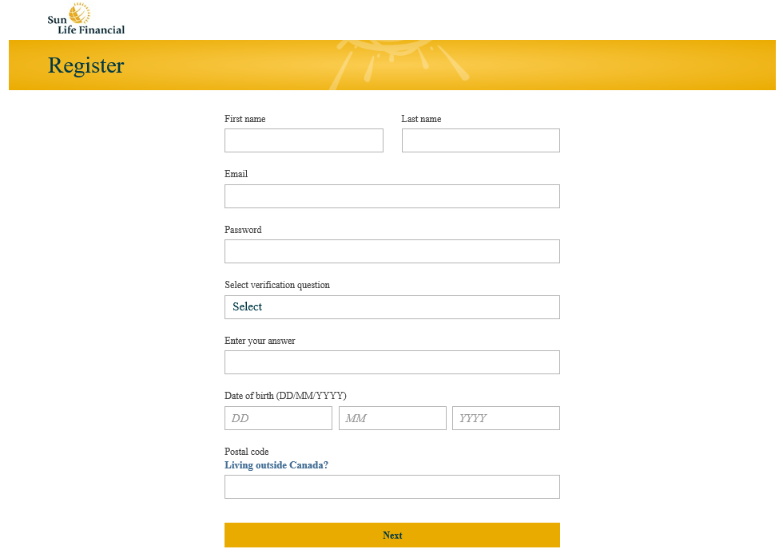
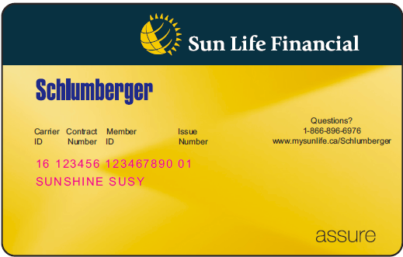
Sign up for Sun Life
One to two weeks following enrollment
Go to www.mysunlife.ca
Click “Register now”

Slide 41
Employee and family assistance program (EFAP)

Slide 42
Morneau Shepell
Employee and Family Assistance Program
Confidential help with work and life issues
Services include:
Professional counseling including an online program.
Access to subject matter experts.
Online resources, tools, articles, action plans and self-directed help kits on real and relevant issues
workhealthlife.com or 1-866-833-7690
Family Support | Financial Support | Legal | Health Coaching
Naturopathic Service | Nutrition | Work/Life Balance

Slide 43
fINANCIAL Benefits

Slide 44
Schlumberger’s Financial Benefits
Schlumberger Canada Retirement Savings Program
Defined Contribution Pension Plan (DCPP)
Deferred Profit Sharing Plan (DPSP)
Group Registered Retirement Saving Plan (RRSP)
Tax Free Savings Account (TFSA)
Discounted Stock Purchase Plan (DSPP)

Slide 45
Schlumberger’s Retirement Savings Plan
Schlumberger Retirement Savings Plan
DCPP
DPSP
Company contributions
DCPP, RRSP TFSA
Your contributions

Slide 46
Defined Contribution Pension Plan
Eligibility
First month following three (3) months of service
Contributions
Employee: 0-5% of admissible compensation
Employer Basic: 2% of admissible compensation
Employer Match: 100% match on first 3% of employee contributions
Investment/Admin fees
Employer paid
In-service Withdrawals
Not permitted
Vesting & Locking-in
Immediately

Slide 47
Deferred Profit Sharing Plan
Eligibility
First of the month following one (1) year of service
Contributions
Based on profitability, the Company will contribute up to 15% of your admissible compensation to your DPSP account
Investment/Admin fees
Employer paid
In-service Withdrawals
Not permitted
Vesting & Locking-in
After 3 years of service

Slide 48
Registered Retirement Savings Plan (RRSP) Optional
Eligibility
Immediately eligibility
Voluntary participation
Employee Contributions
Voluntary unmatched contributions permitted up to your personal CRA RRSP limit
In-service Withdrawals
$25.00 fee per withdrawal
Transferring in
Lump sums and transfers in permitted

Slide 49
Tax Free Savings Account (TFSA) Optional
Eligibility
Immediately eligibility
Voluntary participation
Employee Contributions
Voluntary unmatched contributions permitted up to your personal CRA RRSP limit
In-service Withdrawals
$25.00 fee per withdrawal
Transferring in
Lump sums and transfers in permitted

Slide 50
Retirement Savings Plan Auto Enrollment
DCPP
Employees will be automatically enrolled into the DCPP at the maximum contribution level of 3%
Investments
Contributions will automatically be invested in the Sun Life Financial Granite default fund with the maturity date closest to, without exceeding, your 65th birthday.
Your beneficiary designation will default to your estate.

Slide 51
Pension and Profit Sharing Package
You will receive a welcome package from Sun Life 4-6 weeks after start date
No set enrollment period
Access your account on-line to:
Adjust contribution levels
Change your investment options
Enroll in a TFSA or RRSP
Designate your beneficiary

Slide 52
Discount Stock Purchase Plan (DSPP)
You will be eligible to access this program in June – watch for the invitation email
The Schlumberger Discounted Stock Purchase Plan (DSPP) lets you buy shares of SLB stock at reduced price
You may invest from 1% to 10% of your admissible compensation through payroll deductions
Your contributions used to purchase shares at the end of the purchase period (June 30 and December 31)
There are two purchase periods every year: January 1st to June 30th and July 1st to December 31st. The plan looks at the average share price on the first day and the last day only of the purchase periods (and not any day in-between)
The price you pay is discounted 7.5% of the lower of the 2 days average share price

Slide 53
Resources

Slide 54
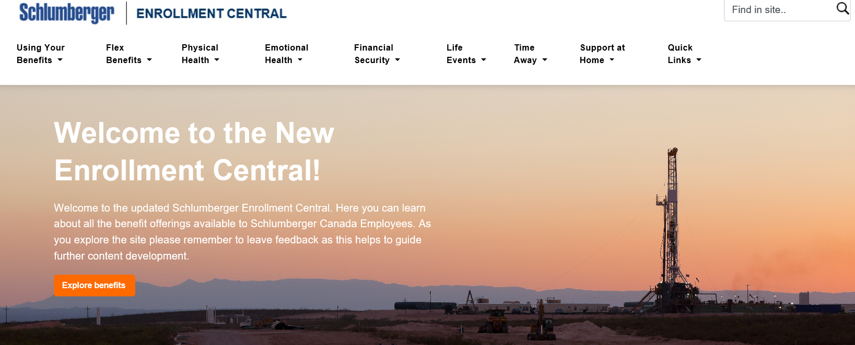
Want more information?
slb-benefits.ca

Slide 55
Websites and Questions
Enrollment Central – Primary Benefits Resource
www.slb-benefits.ca
Canada HR Hub Home Page
https://slb001.sharepoint.com/sites/EmployeeBenefits/Pages/HRCountry.aspx?slbHubCountry=16
AskHR is your one-stop shop for all HR related questions
1-877-9-ASKHR-9 1-877-927-5479
Online : http://askhr.slb.com
E-mail: askhr@slb.com

